Slide 1

New Employee Enrollment Process
Project dev

Slide 2
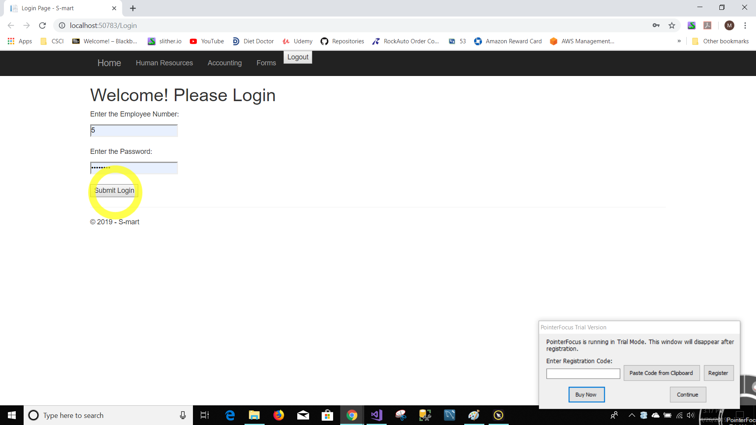


Slide 3
Login
Employee Number
Password
Submit Login Button

Slide 4
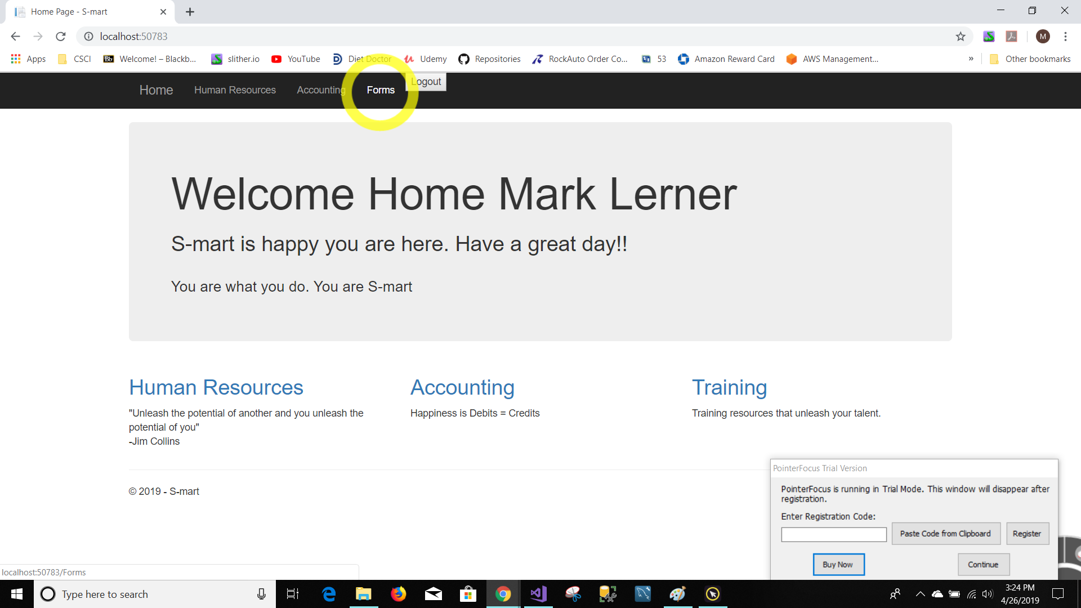


Pencil sharpening
You may sharpen your pencil any time except for during whole-class instructions, activities, or lessons.
Mechanical pencils are also allowed!

Slide 5
Home Page
Navigation Bar
Forms
Quickly go anywhere in the intranet

Slide 6
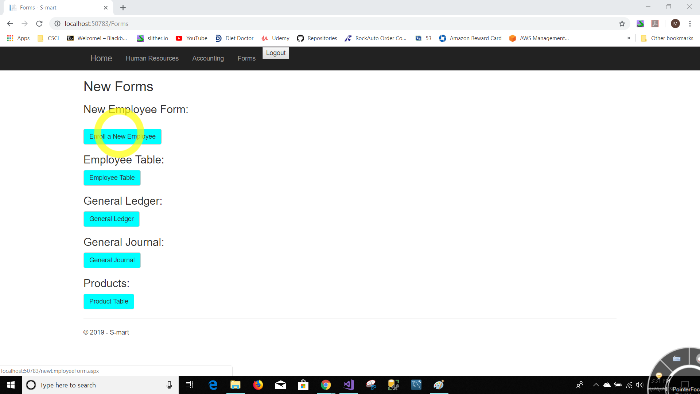



Assignments
Using your class time wisely will decrease the amount of work you need to complete at home.
Please record your first and last name on all of your assignments.
Completed assignments should be turned in to the tray on the table in the front of the room.
Assignments will be graded and returned to you each Friday.

Slide 7
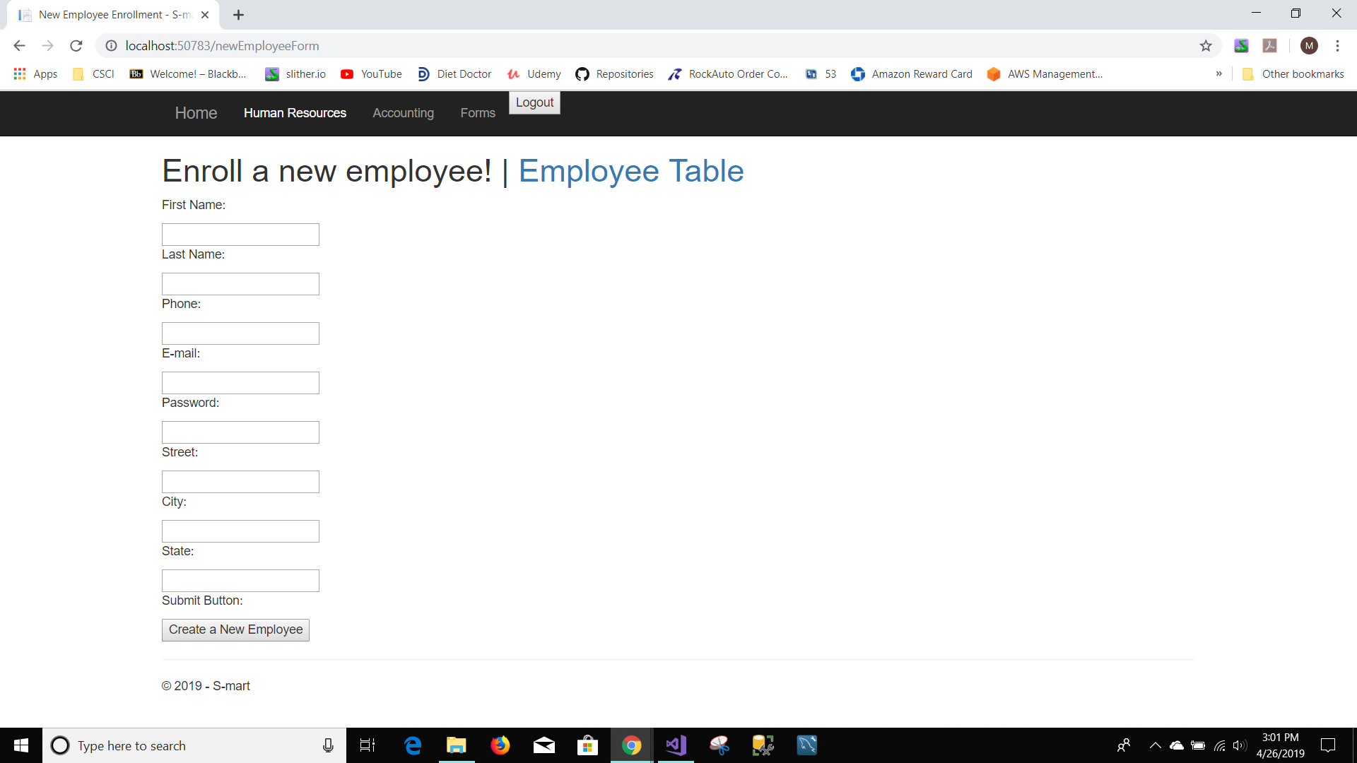
Lining up for recess, lunch, and other activities
I will invite one group at a time to line up facing the classroom door.
01
Please be respectful and represent our class in a positive way.
02
The first person in line may hold the door for the rest of the class, and the last person in line may turn off the classroom light.
03

Slide 8
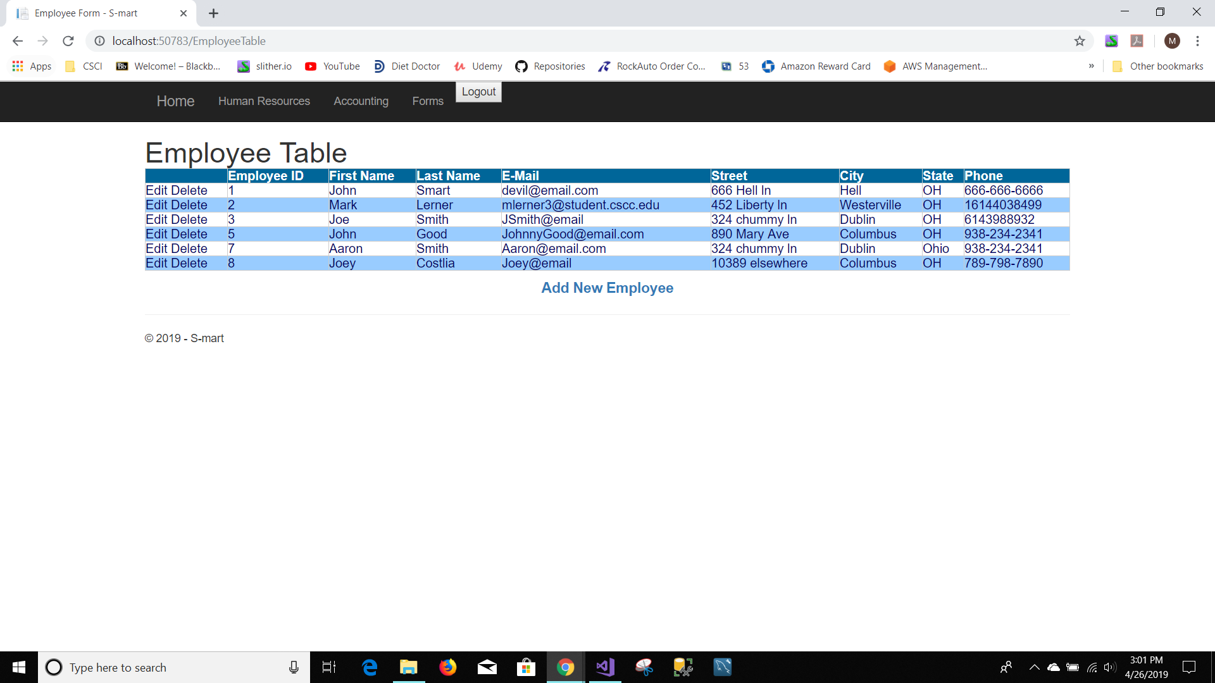




How and when to contact me?
I want you to have a great and successful year!
You may visit with me about questions or concerns any time we are not in the middle of direct instruction, or I am not helping other students.
You may email me if necessary, and I will respond when I am able.
I am available for extra help before or after school. When possible, please let me know in advance so I can plan accordingly.

Slide 9
Bought to you by Project Dev
Thank you for watching
on how to create a
New Employee

